Slide 1
NSU_Inception

Slide 2
Team Members

Slide 3
Category: Living In Our World
Sub-category: Smash Your SDGS
Saving The World

Slide 4

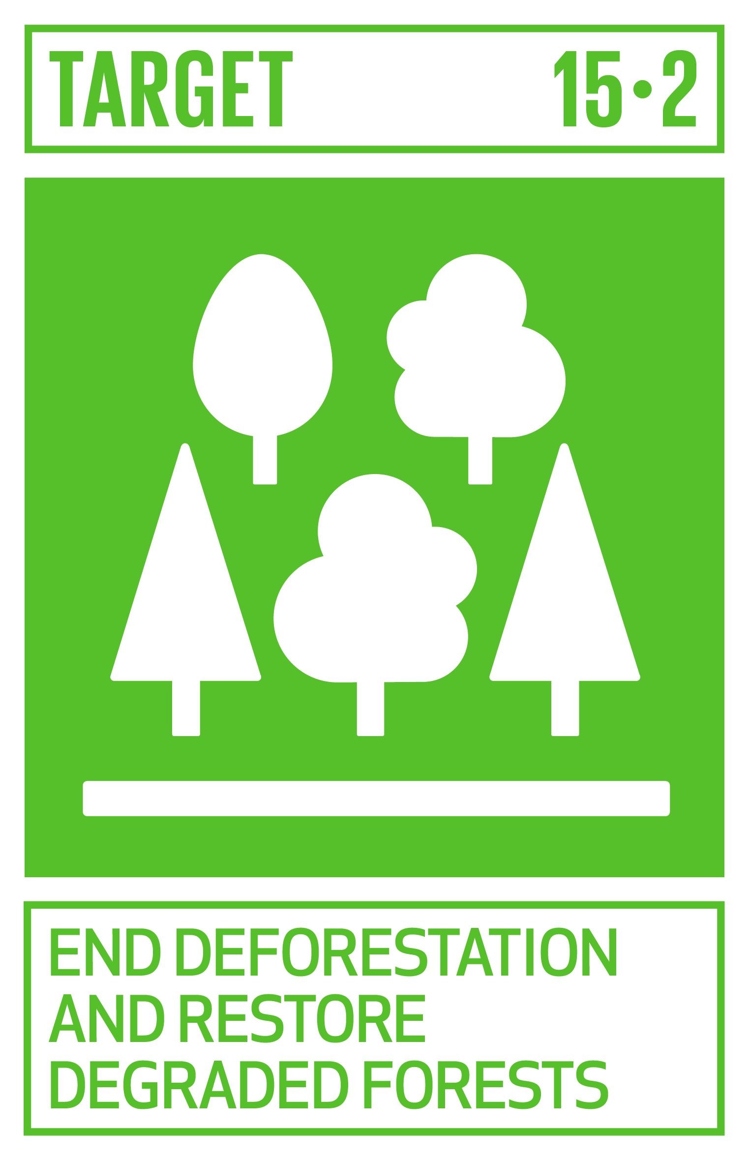
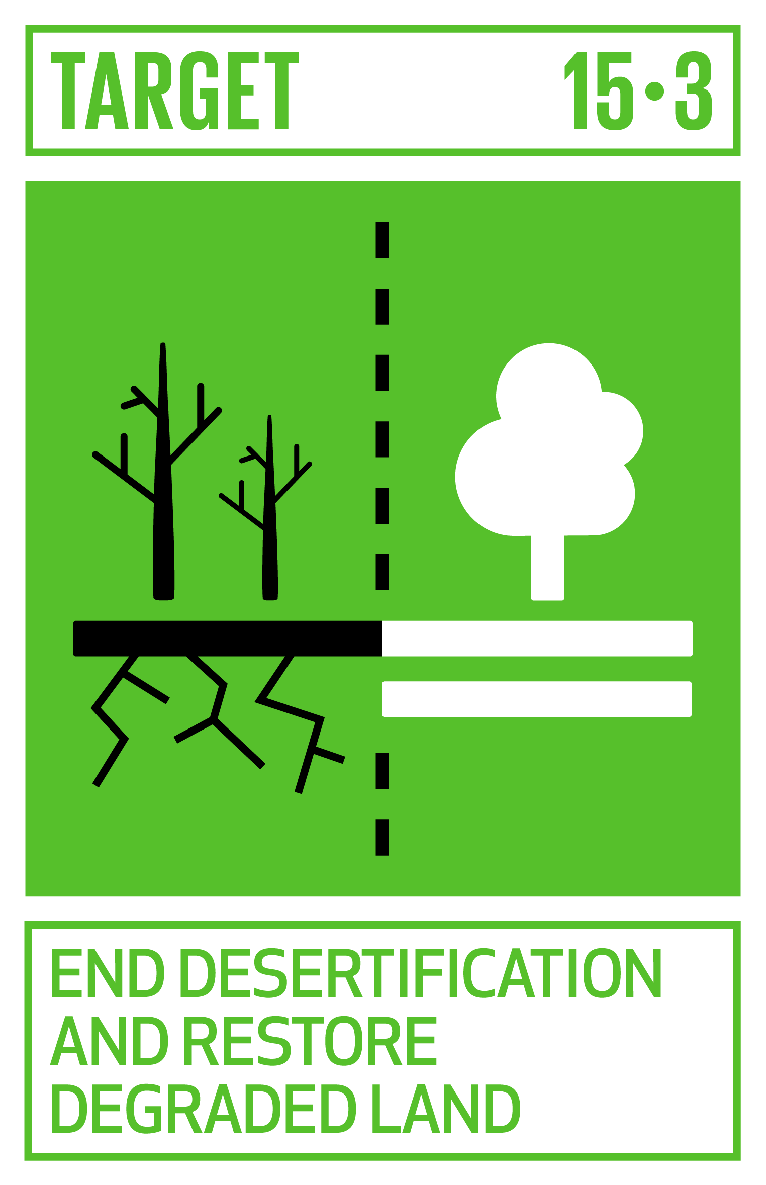

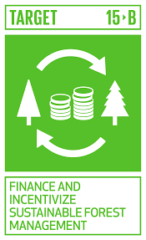
Facts OF SDGS

Slide 5
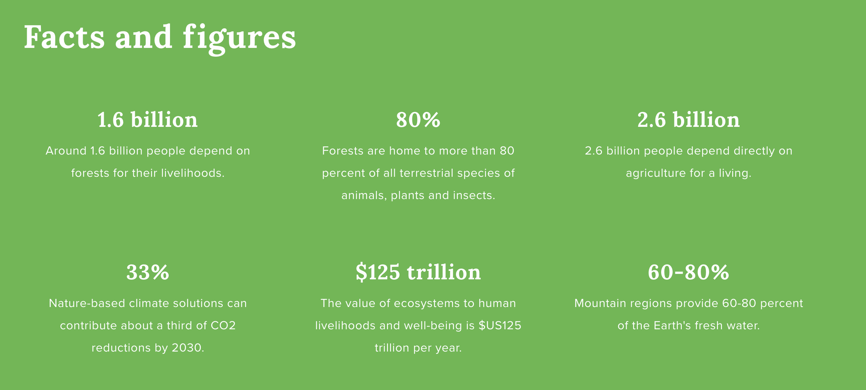

Slide 6

Our Objectives
Life On Land
Find Out Problems:
Animal Related Issues
Land Related Issues
Crops Related Issues
Water Related Issue

Slide 7
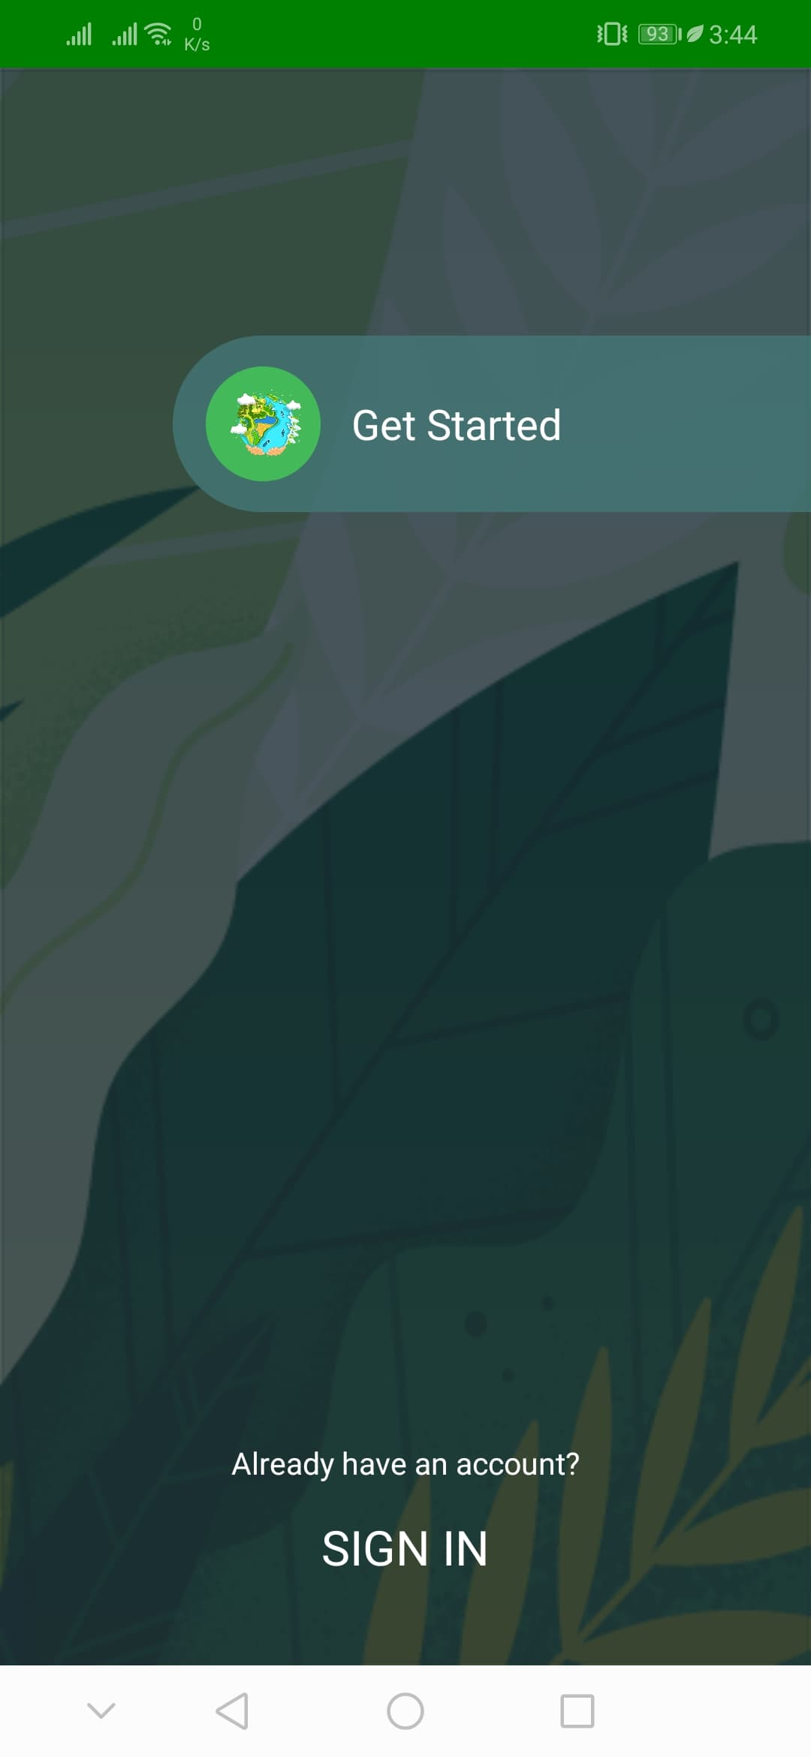
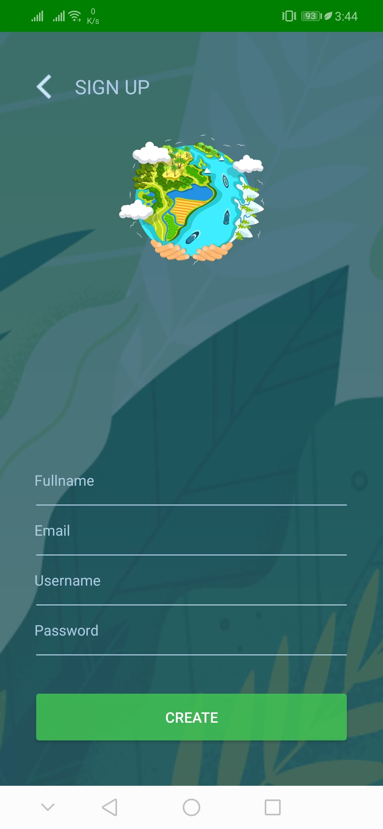
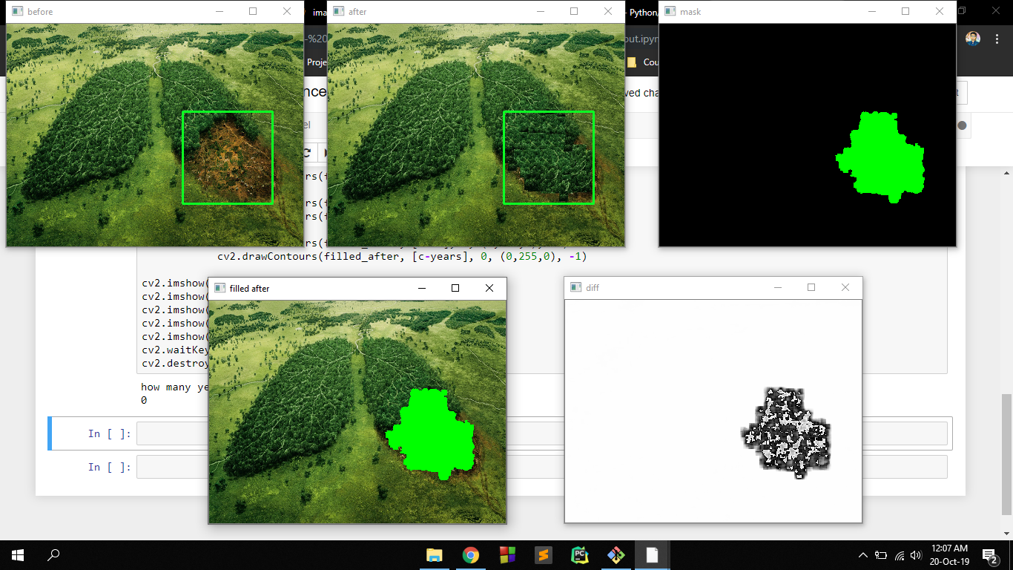
Our IDea
Mobile Application
Data Analyzing Process

Slide 8
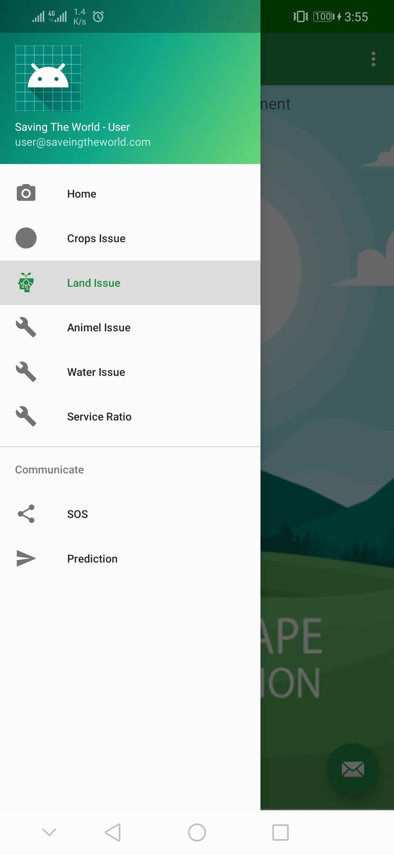
App Features
Land comparison
Deforestation ratio
Visualization
Impact visualization

Slide 9
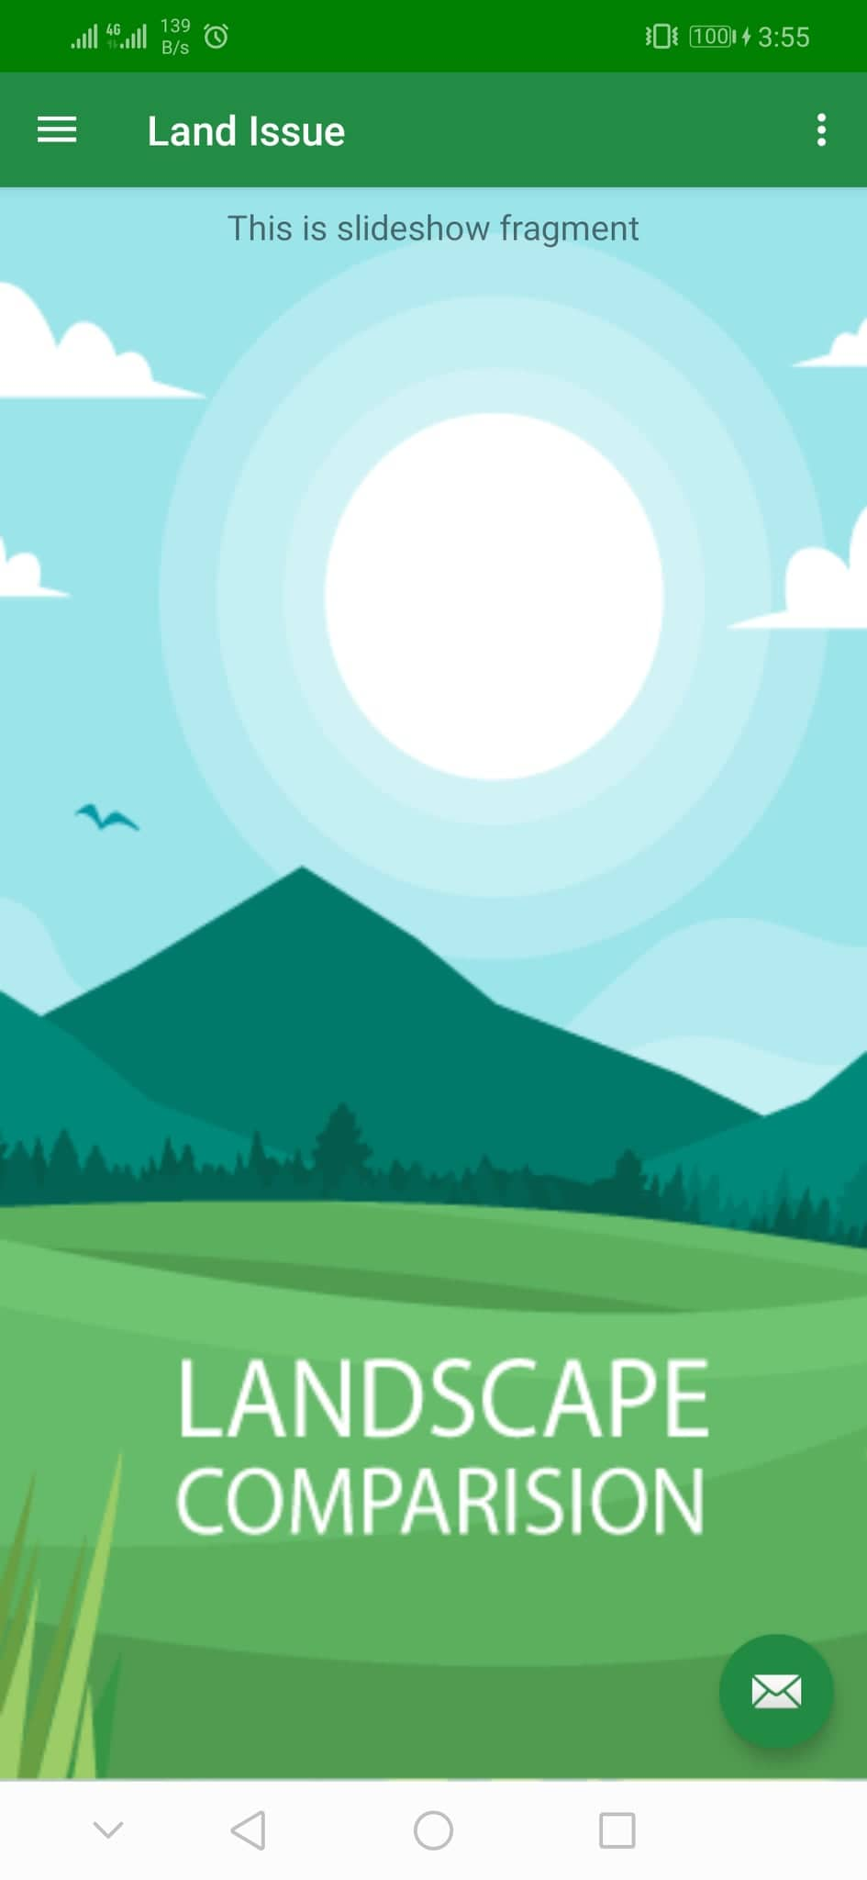
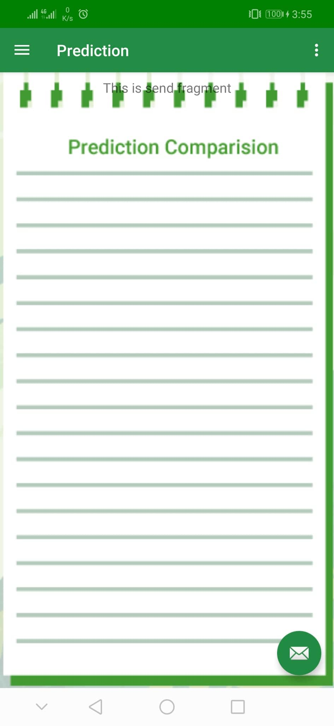
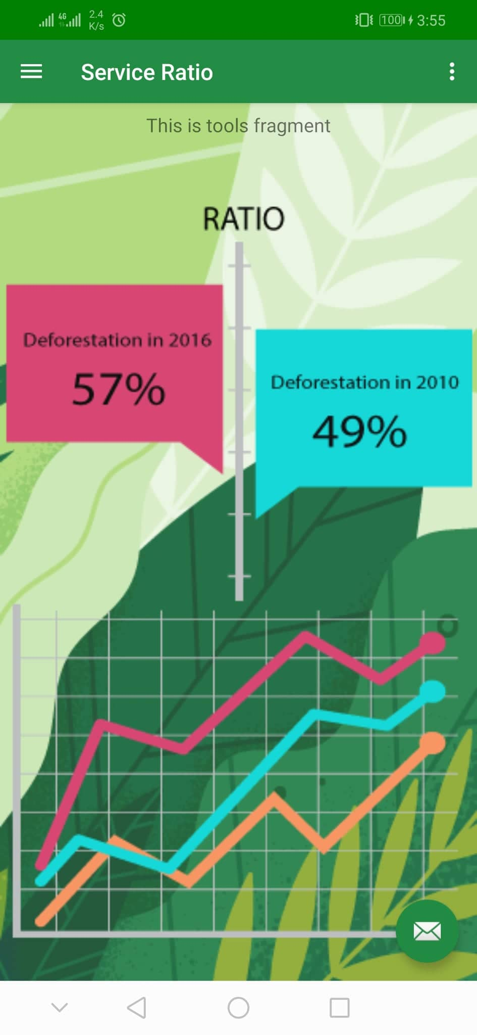
App Features

Slide 10
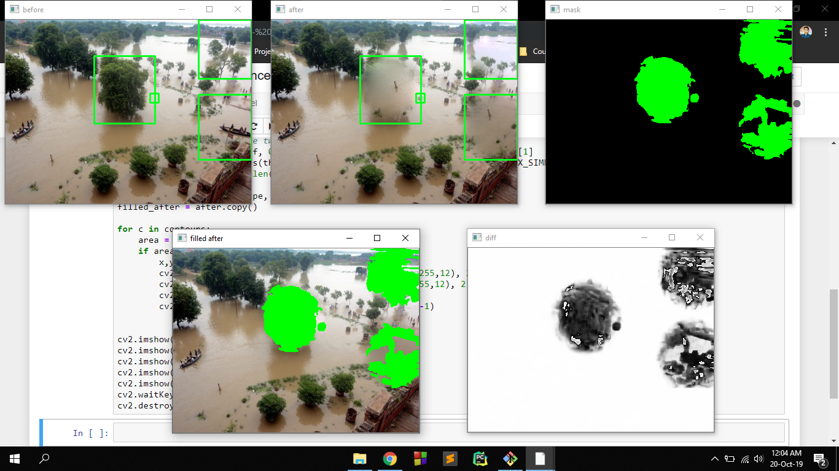
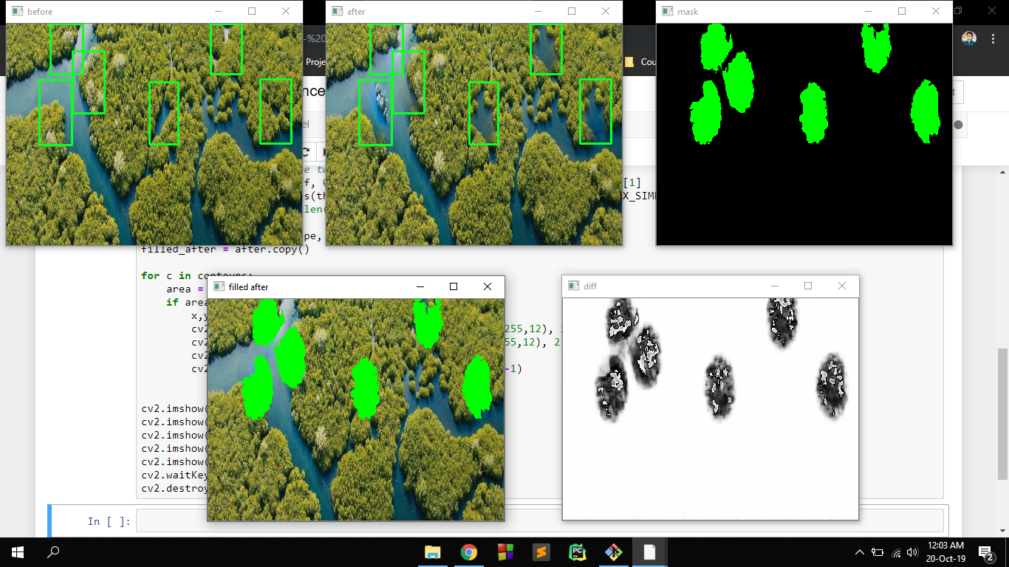
Data Analyzing

Slide 11
What makes us different !
Real Time support and visualization
Impact visualization

Slide 12
Conclusion
Impact, Creativity and validity , 3 steps for analyzing a project. In our project, impact is clearly seen as it was one of our core functionality. Creativity can be reflected through the way we have merge different domains together. It is fully practical project which analyzes its validity itself.

